Slide 1
Computational Method in Physics Fall 2017
Modified Final Project
by
Sahana Bhattacharyya

Slide 2
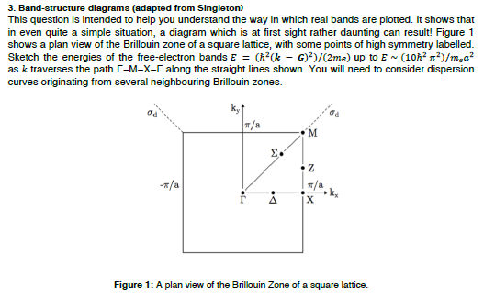
Modified Problem
Draw a 3D cubic Lattice and showing its Energy band diagram according to Free electron model
Modification of the Dispersion Curve according to Nearly Free Electron Model

